Slide 1
The Changing World of Work
How to stay ahead of the curve
Year 10 Personal Learning Plan

Slide 2
Questions for today:
What will a career path look like in 2022.
Will technology really take over our jobs?
What’s an Entrepreneur?
How can data help guide your future?
What is helpful on your career journey?

Slide 3
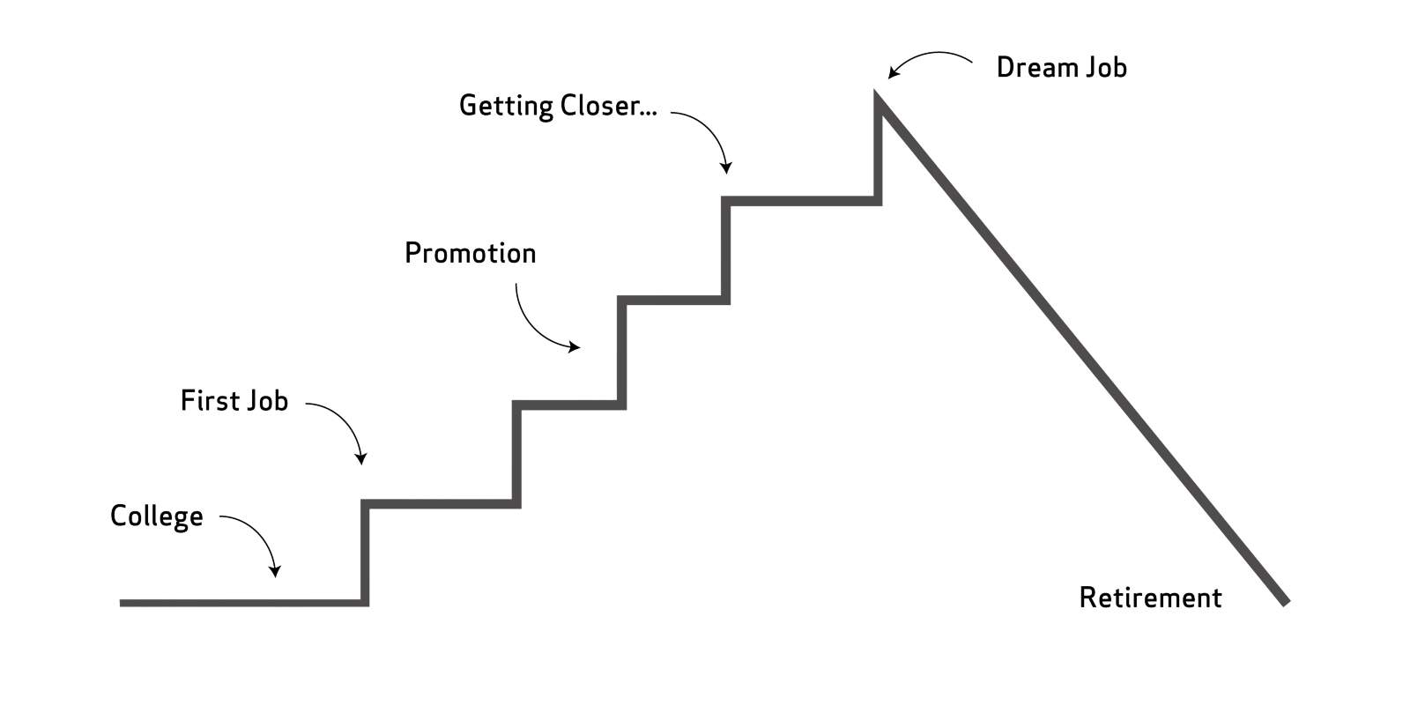
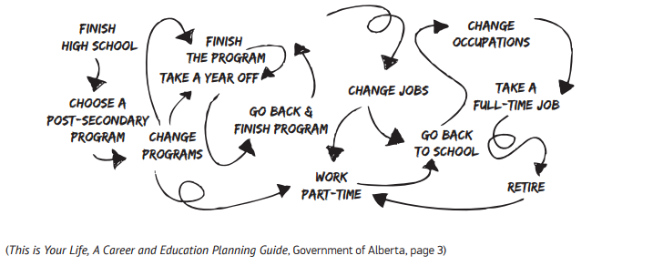
Career paths aren’t ladders, they’re more like jungle gyms.
How it used to be.
How it is now.
https://alis.alberta.ca/media/698070/tiyl-students-web-version-optimized-final.pdf

Slide 4
Technologies that will change the way we work.

Slide 5
Using new technologies in new ways.

Slide 6
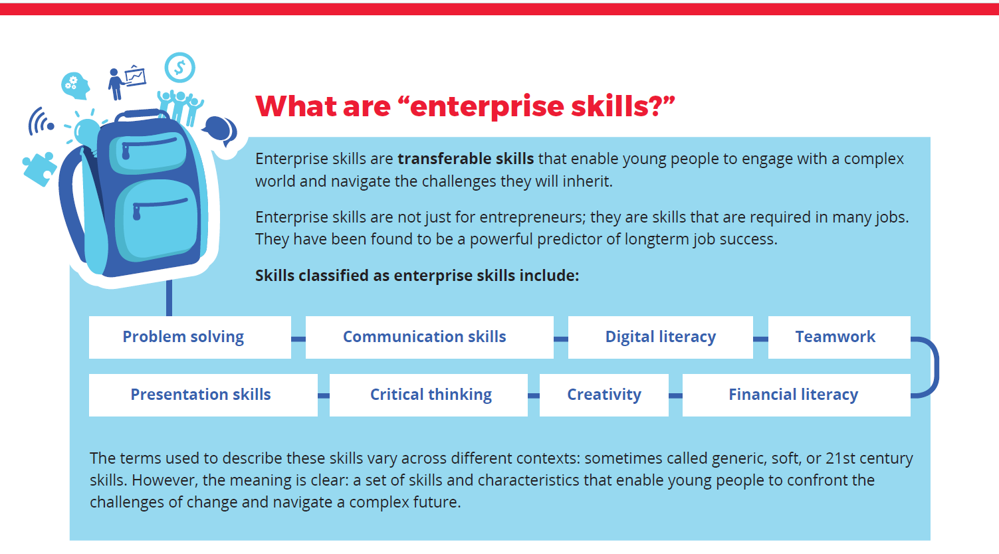
Technology that leads to new opportunities.
Source: The-New-Basics_Update_Web pdf 2017 (fya.org.au page 5)

Slide 7
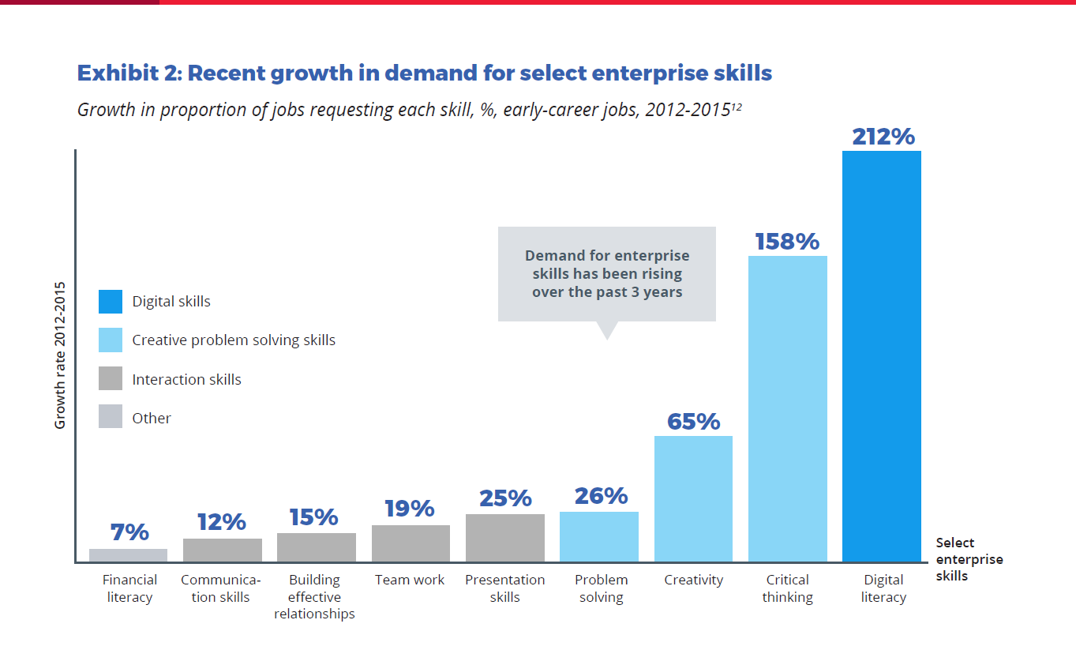
The-New-Basics_Update_Web pdf 2017 (fya.org.au page10)

Slide 8
EMPLOYMENT DATA
Why is it important?
Where do you find it?
Can you believe it?
Check it with the C.R.A.P. test.
Currency, Reliability, Authority, Purpose/Point of View

Slide 9
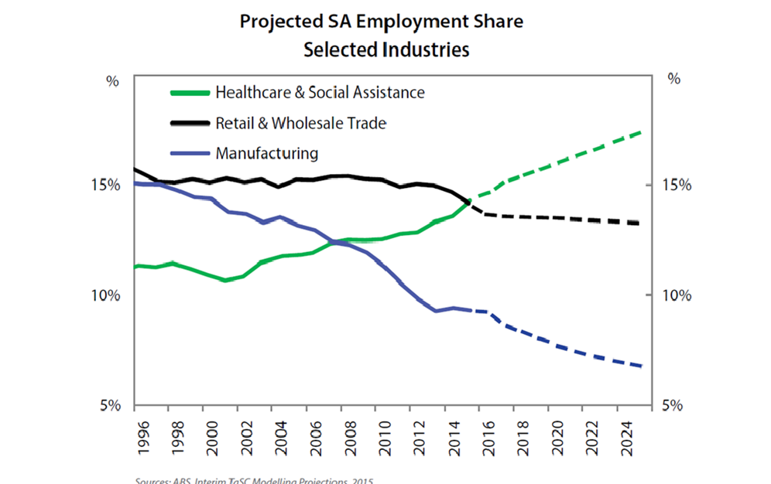
Employment Trends
Source: ABS Interim TaSC Modelling Directions 2015 Retrieved November 12, 2018

Slide 10
Government information with the processes explained.
Presents data that is gathered regularly and updated.
Available for all regions across Australia.
http://lmip.gov.au/default.aspx?LMIP/EmploymentProjections Retrieved November 18, 2018

Slide 12
Skills employers are looking for.
Digital Literacy
Financial Literacy
Critical Thinking
Presentation Skills
Skills you need to get a job and keep a job.
Communication – verbal and written
Motivation
Reliability
Teamwork
Personal Presentation Relevant and up-to-date resumes and application letters

Slide 13
5 Points to Remember throughout your career.
Change is constant
Follow your heart
Keep learning
Focus on the journey
Access your allies
Opportunities arise during times of change. Be flexible, versatile and adaptable.
The pursuit of dreams provides motivation and direction. You do better when you do the things you love.
Learning in all contexts is a lifelong process. This is a continuous cycle throughout your career.
Career building requires goals that are set for the long-term as well as the small steps along the way.
There are potential career allies to be found in many places. Build networks and be part of the networks of others.
(https://alis.alberta.ca> succeed-at-work ‘Try the High 5 Approach to Succeeding at Work and Life’)

Slide 14
Some Pathway Options: So you’re thinking about………
Leaving school and getting a job.
Finishing Year 12 and going to uni.
Finishing Year 12 and going to TAFE or another training organisation .
Starting an apprenticeship while you’re still at school.
You’re not really sure.
Who can I talk to about any of the above?
At School: In the Skills Centre: At Home: friends and family, and others
Ms Rowe Mr Ricci
Mr Cashel Ms Harrison Mr Oswald Ms Gowers

Slide 15
Useful references for starting your Career Journey

Slide 16
References used in this presentation:
Employment data.
http://www.tasc.sa.gov.au/DesktopModules/Bring2mind/DMX/Download.aspx?Command=Core_Download&EntryId=678&PortalId=5&TabId=1047
http://lmip.gov.au/default.aspx?LMIP/EmploymentProjections
FYA publications and links. https://www.fya.org.au/report/new-work-order
http://www.fya.org.au/wp-content/uploads/2016/04/The-New-Basics_Web_Final.pdf
https://www.fya.org.au/2018/07/03/i-rated-the-4-pieces-of-advice-i-was-given-about-choosing-a-career/
Other resources.
https://www.news.com.au/finance/work/careers/recruiters-name-the-most-epic-jobseeker-fails-theyve-encountered/news-story/6cf3d9386458b68a77730b5cbaeb5434 https://thecusp.com.au/ https://alis.alberta.ca/media/698070/tiyl-students-web-version-optimized-final.pdf
You Tube. https://www.youtube.com/watch?v=8sdUZqOoAq4 https://www.youtube.com/watch?v=8OWhGiyR4Ns https://www.youtube.com/watch?v=1Ghscy7PKo8

